Slide 1
Post-Pandemic Airbnb Market Analysis: New Orleans, LA
By: Sean Oberer, Matt Campbell, Deevanshu Kishor Khatri, Krishna Deepika Chavali, Ambreen Abbas

Slide 2
Overview
Exploratory Data Analysis
Reviews/Listings Topic Modeling
Market Supply/Demand
What makes an Airbnb ‘successful’

Slide 3
Exploratory Data Analysis

Slide 4
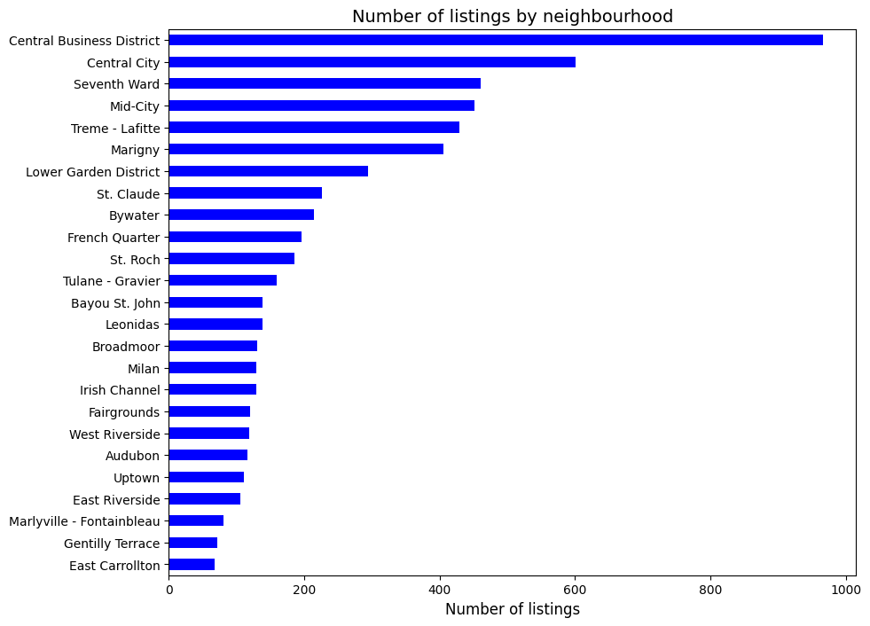
Neighborhoods which are nearby to tourist places have high number of Airbnbs which is expected
Central Business District and Central City has significantly high number of Airbnbs as its proximity to tourist places like Jackson Square and Downtown
Seventh ward, Mid City and Treme-Lafitte are closeby to jackson square and new orleans city park

Slide 5
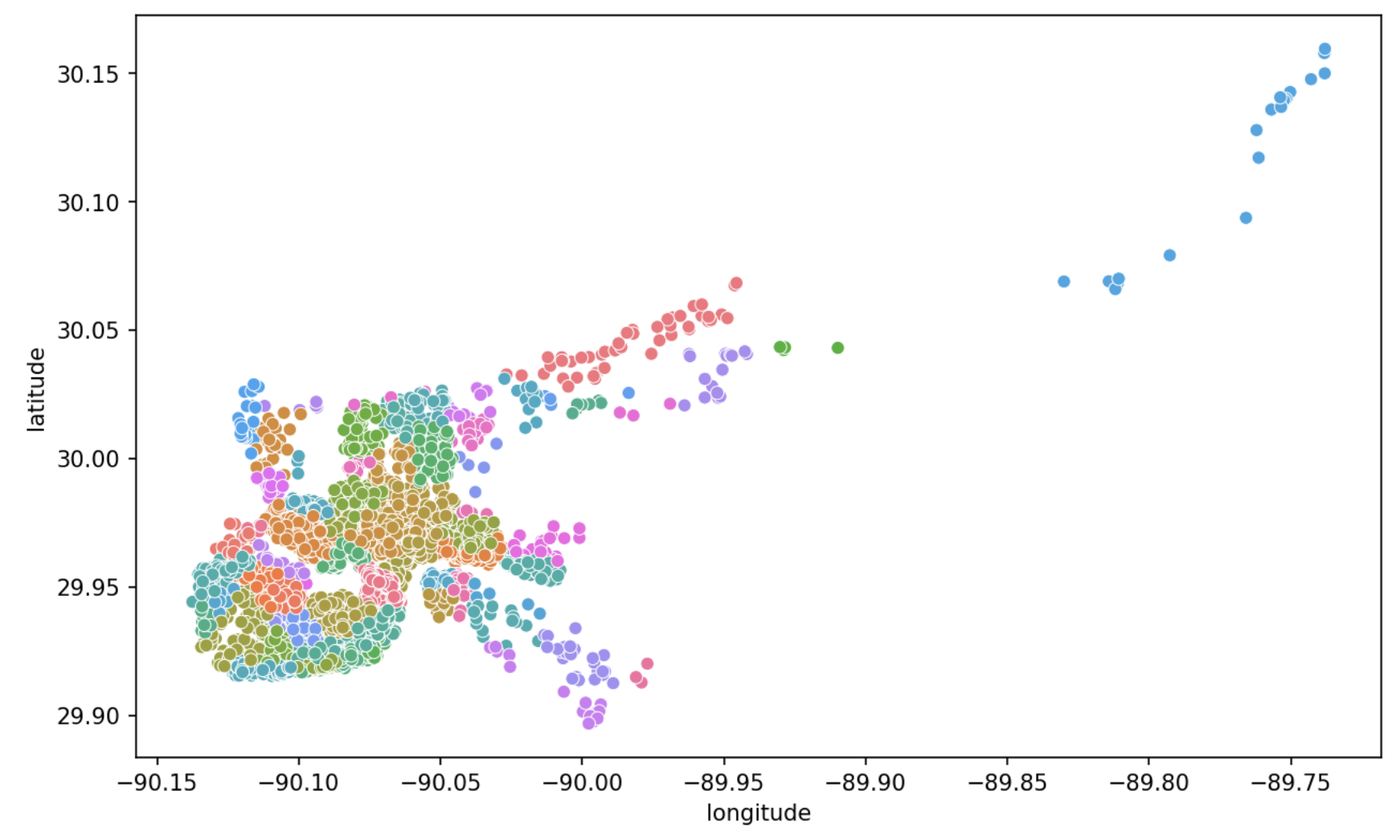
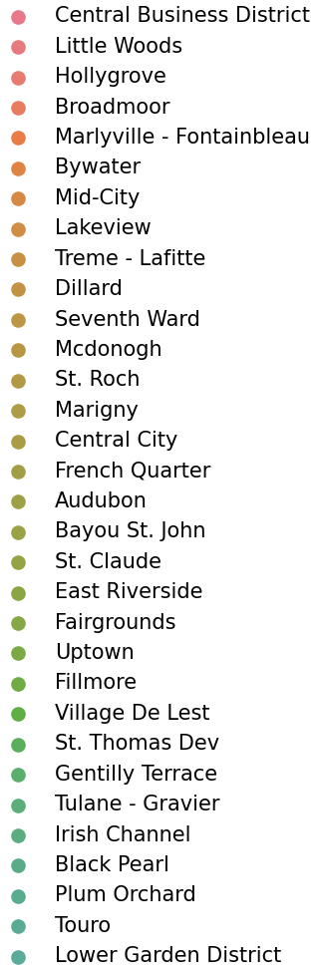
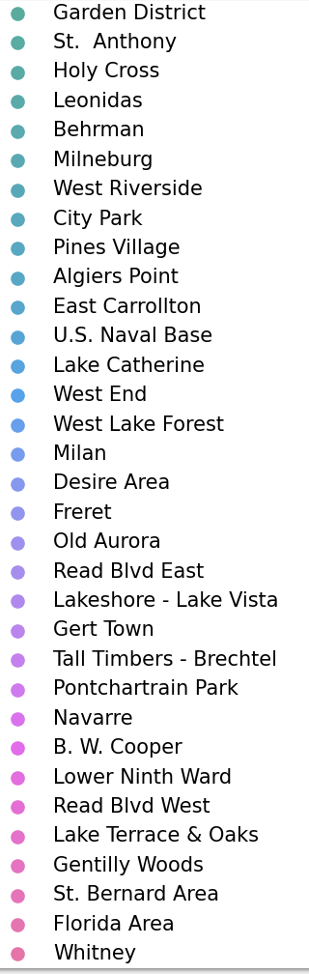
Density of listings by neighborhood

Slide 6
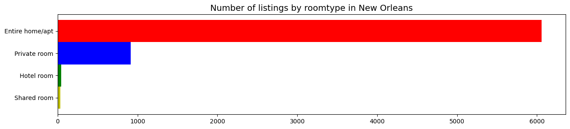
Entire home/apartment is the most preferred Airbnb

Slide 7
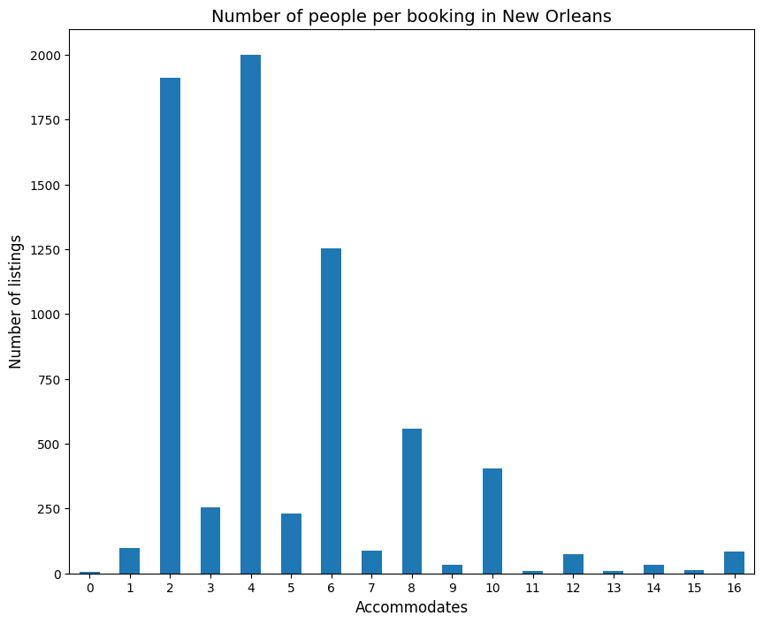
New Orleans is a popular destination for couples

Slide 8
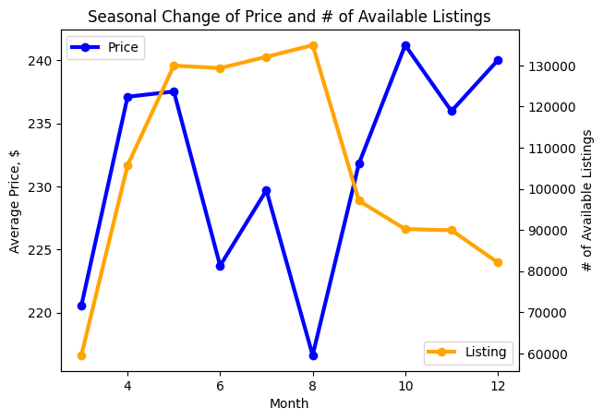
Prices are high during holiday season
Mardi gras mania during Feb - May
Winter holidays during October - December

Slide 9
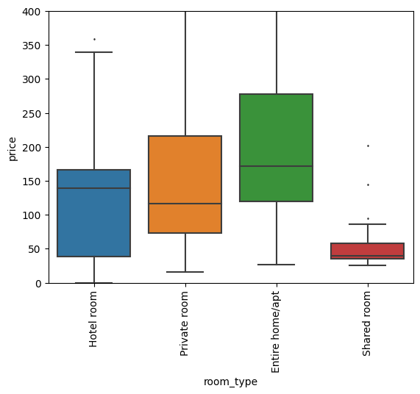
Price variation by room type

Slide 10
What is Said in AirBNB Reviews and Listings?

Slide 11
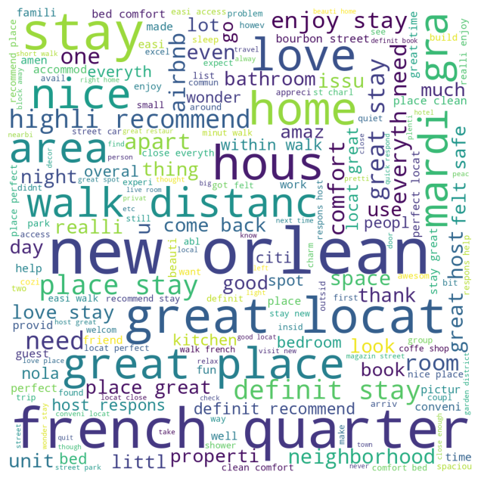
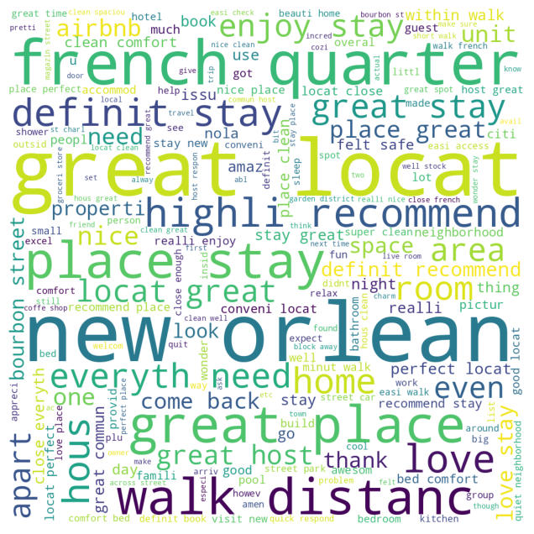
AirBNB Reviews WordCloud
2023 Reviews
Summer 2022 Reviews

Slide 12
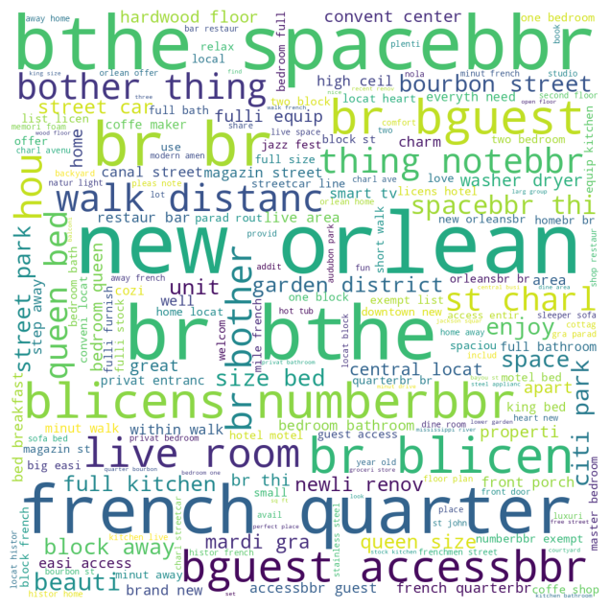
AirBNB Listings Description WordCloud

Slide 13
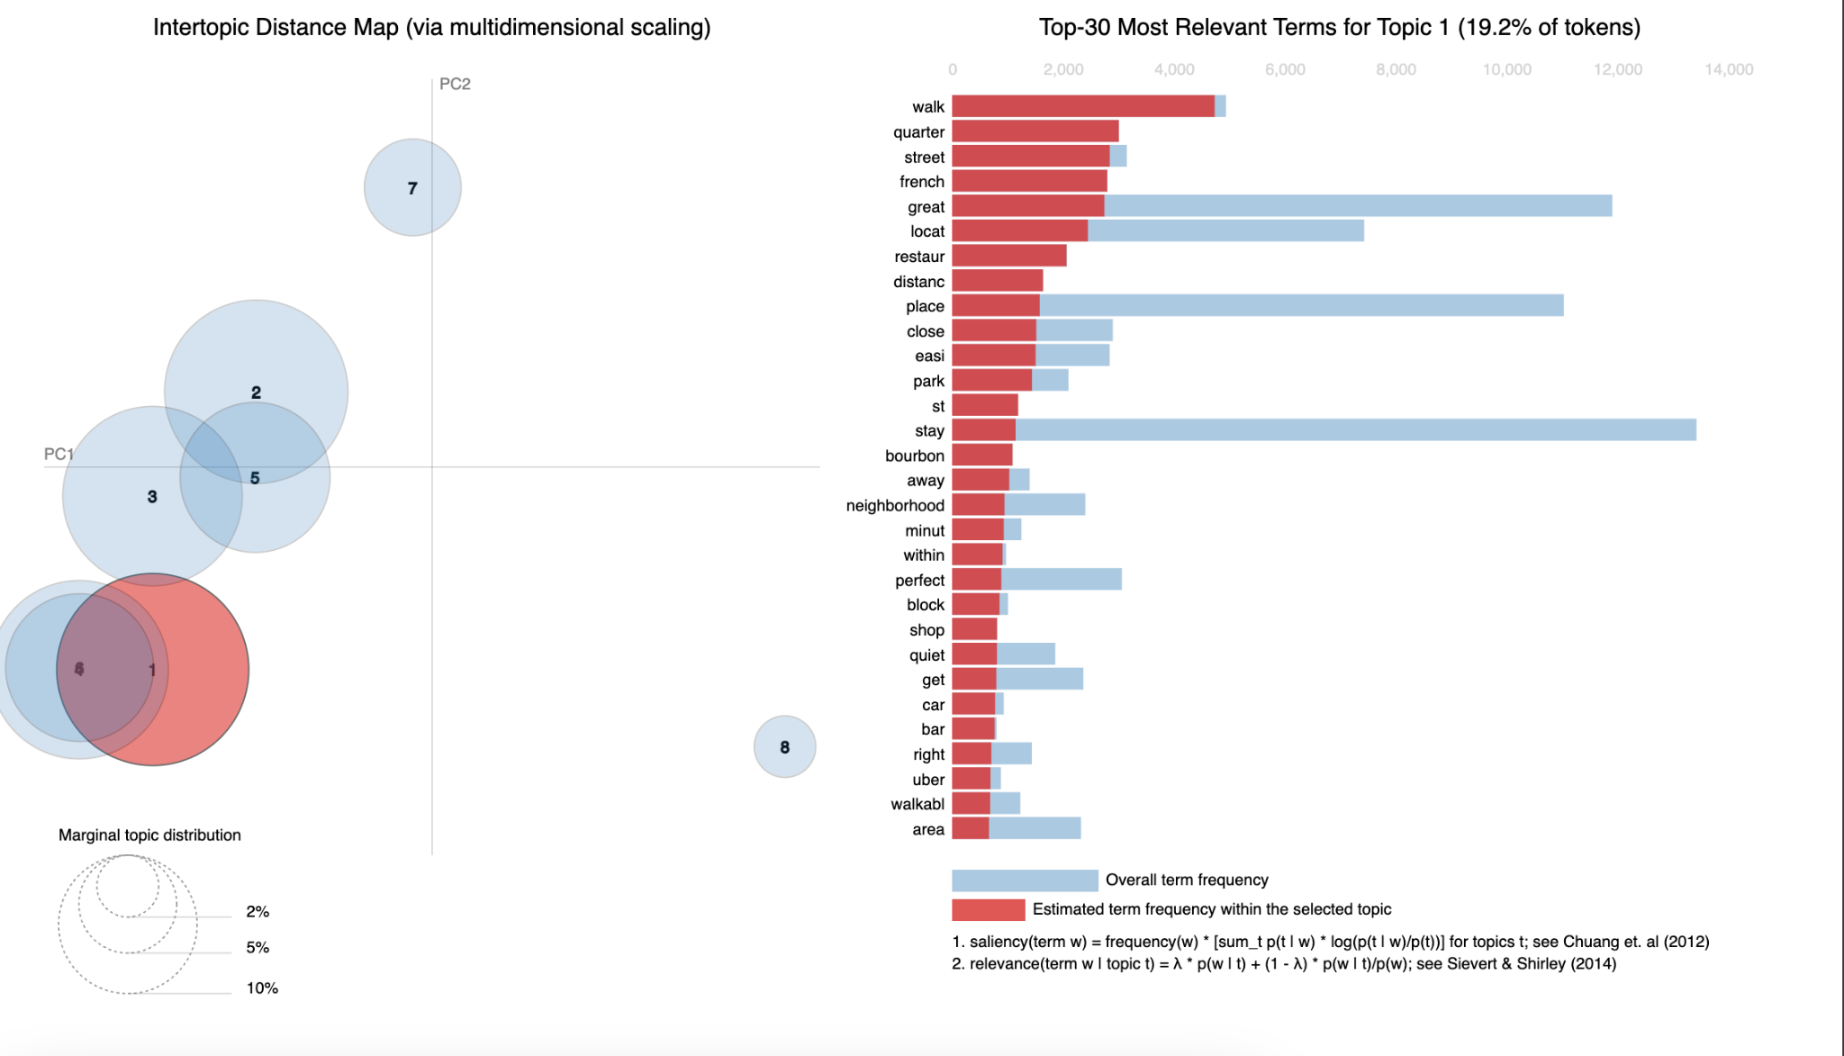
Topic Modeling of AirBNB Reviews: 2023

Slide 14
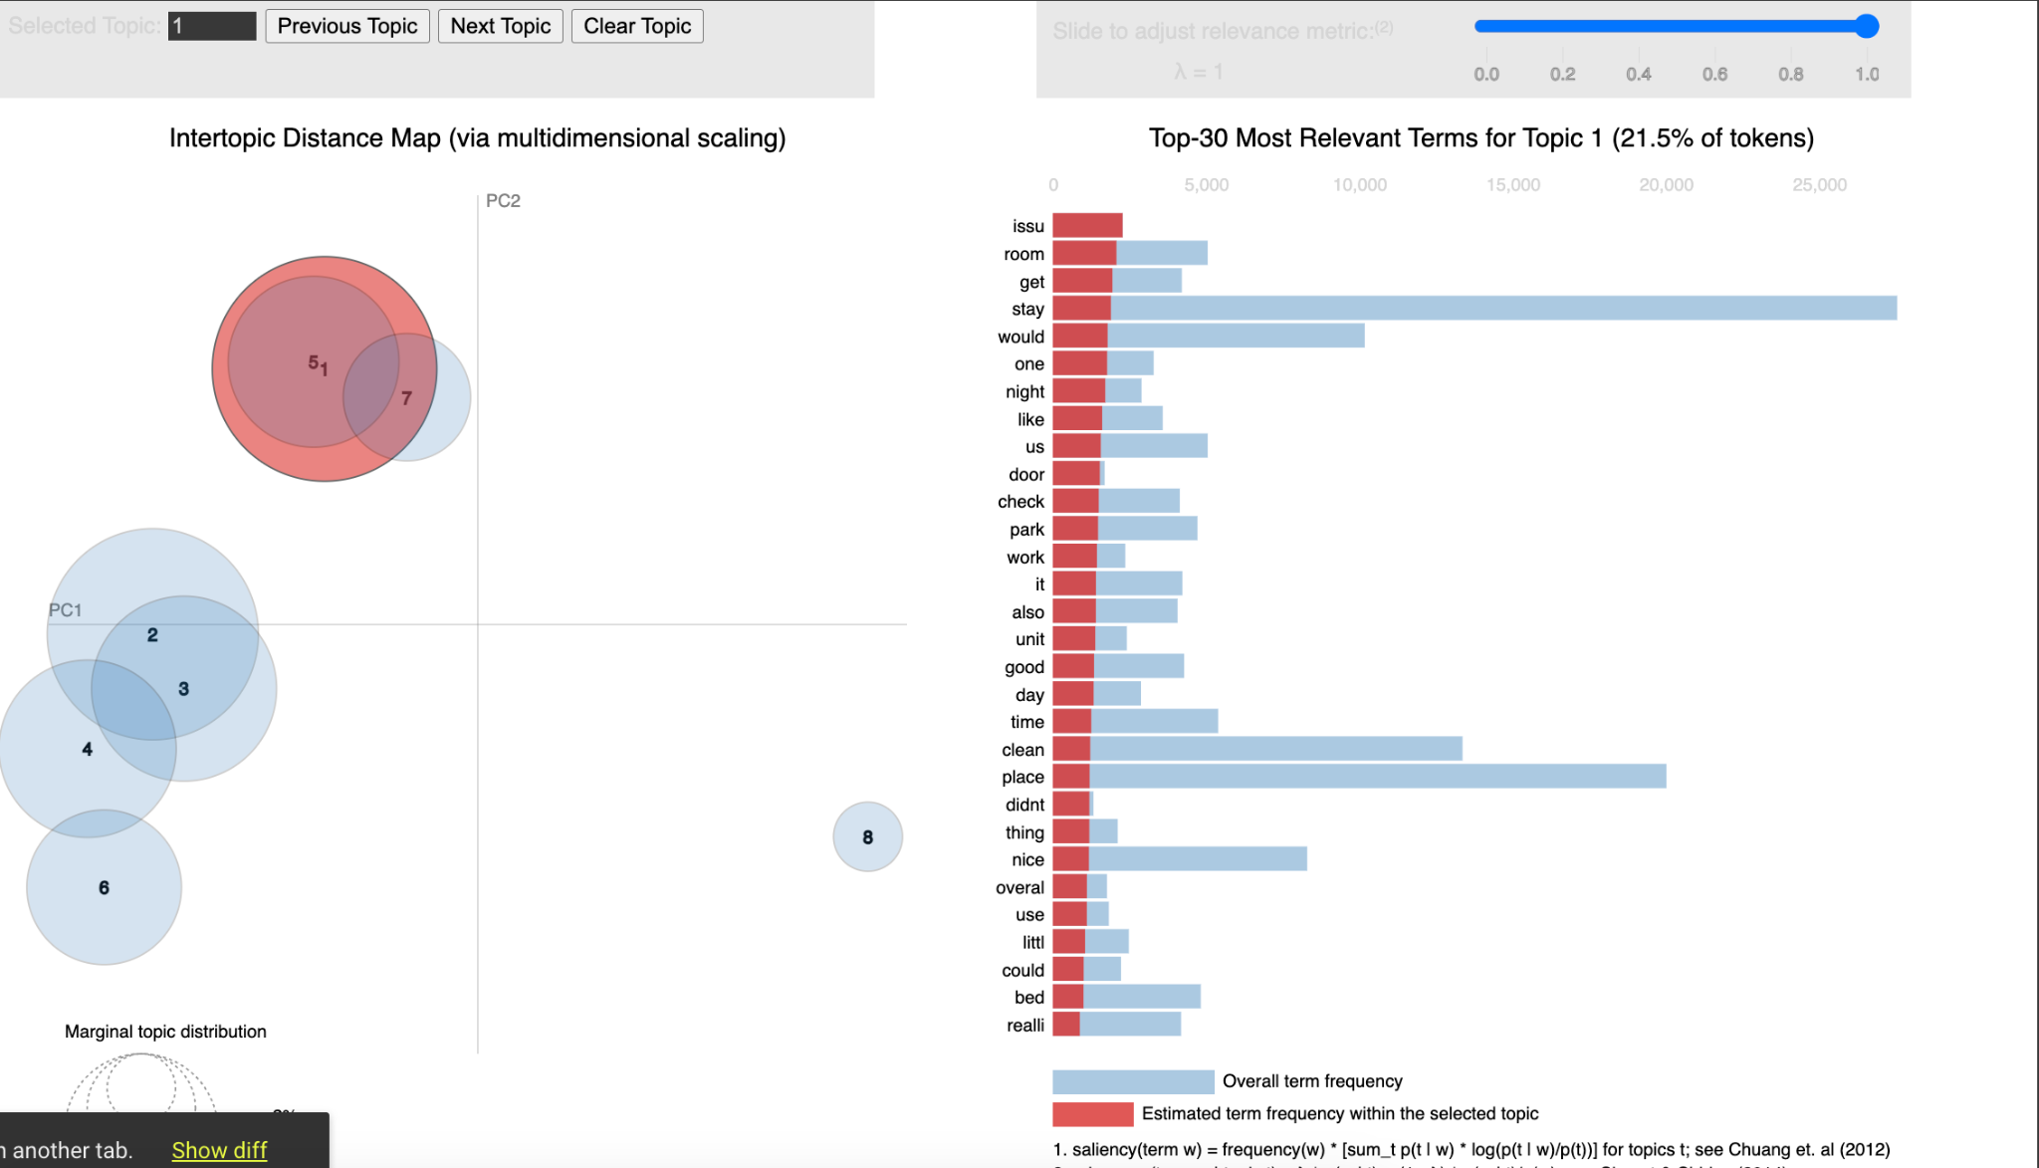
Topic Modeling of AirBNB Reviews: Summer 2022

Slide 15
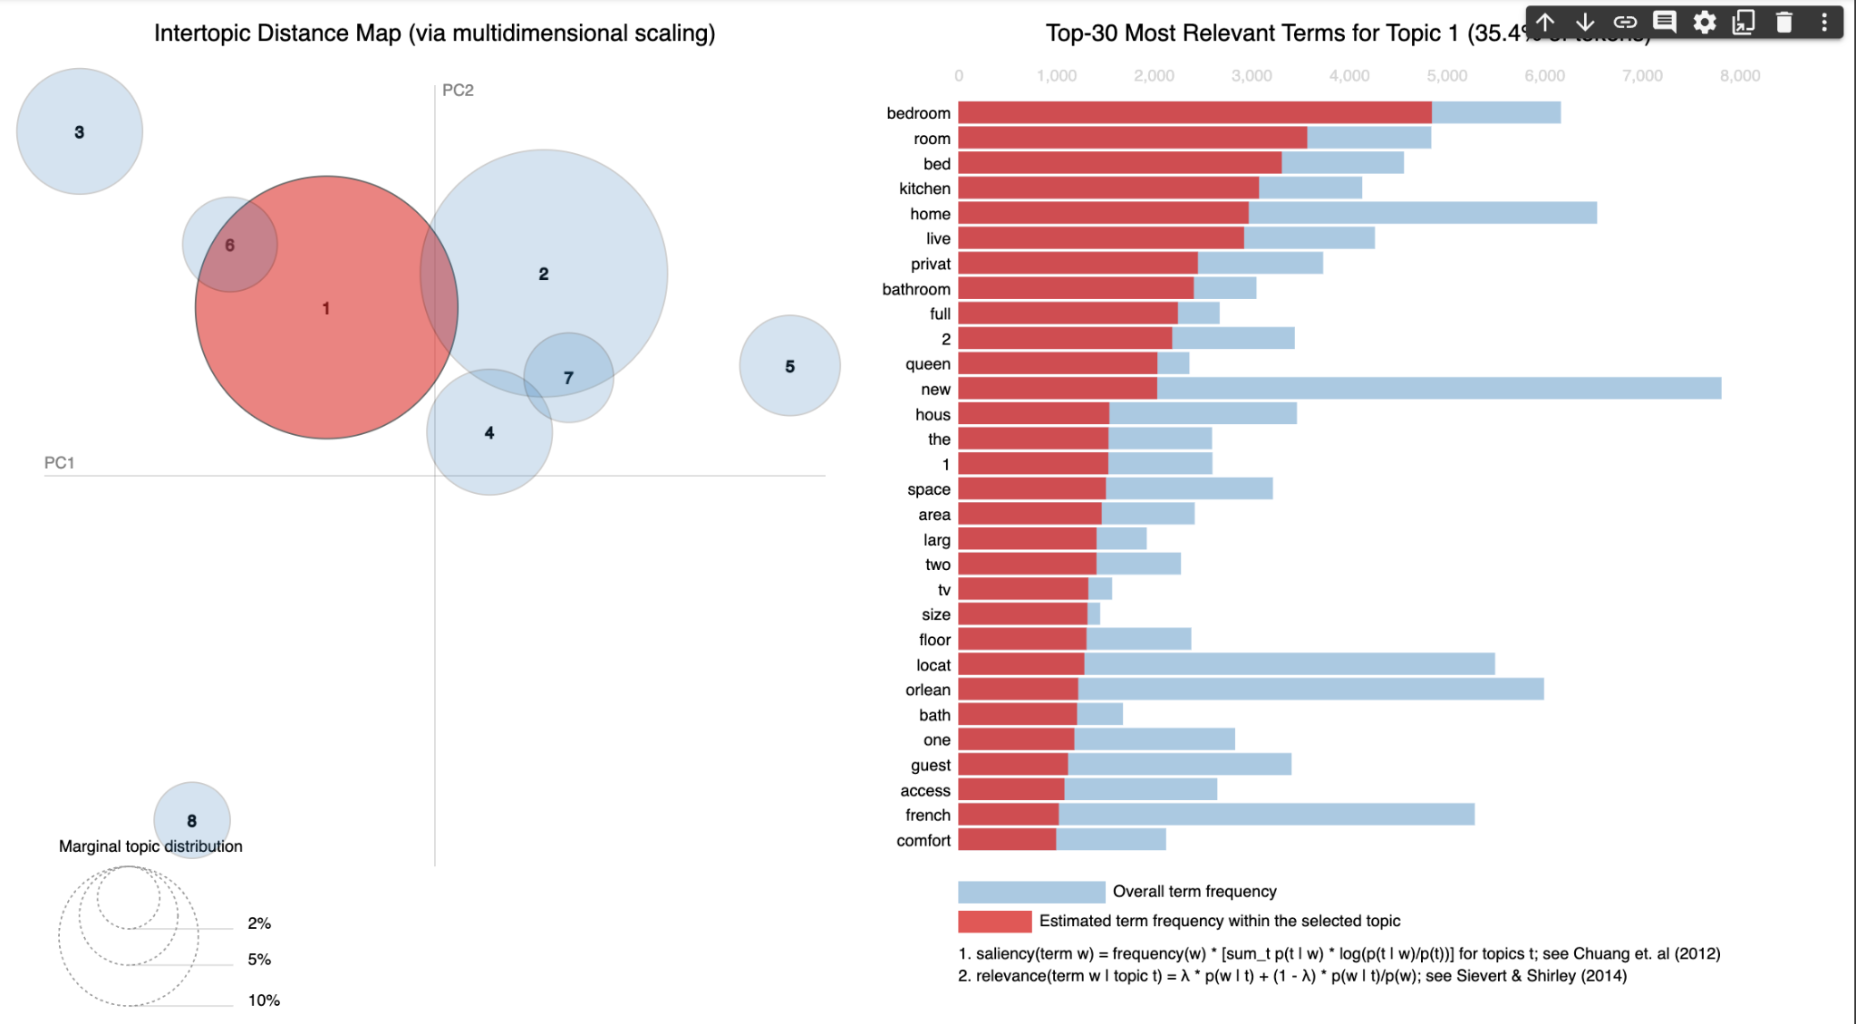
Topic Modeling of AirBNB Listing Descriptions

Slide 16
Market Supply/Demand

Slide 17
Important Definitions
Market supply: the total number of available Airbnb’s over period of time
Market demand: the total number of unavailable Airbnb’s over a period of time

Slide 18
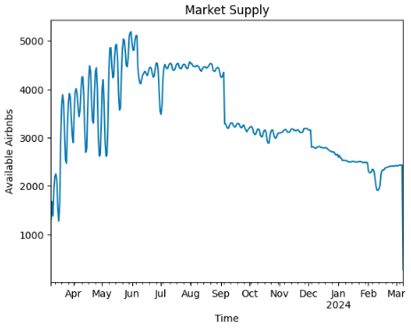
Market Supply Overview
Quadratic trend (increasing then decreasing)
Potential seasonality (peak high and peak low days in Summer months)
Lowest supply from December to March

Slide 19
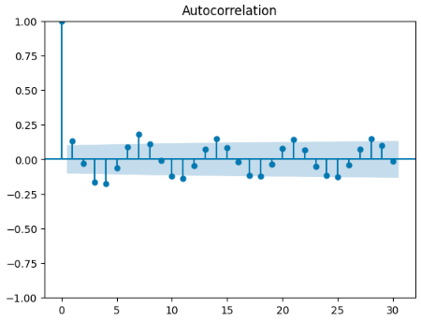
Market Supply Autocorrelation Analysis
No significant indication that seasonality is present based on our correlation values
Interesting patterns with our data where the 3rd and 4th days of each week have a negative correlation
1st and 7th days of each week seem to have a positive correlation

Slide 20
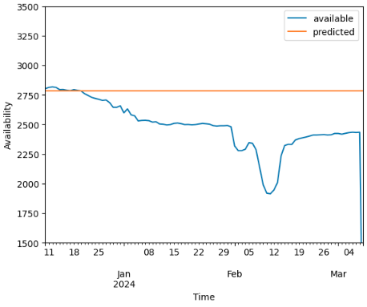
Market Supply Forecasting Model Evaluation
Mean absolute percentage error used as main evaluation metric
Simple Exponential Smoothing model performed the best among models created
Trained on 270 days of data, validated on 90 days of data
22% MAPE
SES model seems to be overestimating market supply

Slide 21
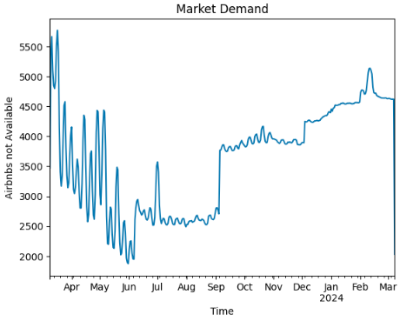
Market Demand Overview
Quadratic trend (decreasing then increasing)
Potential seasonality (peak high and peak low days in Summer months)
Lowest demand from April to September with exception of peak days
Consistently high demand from December to March

Slide 22
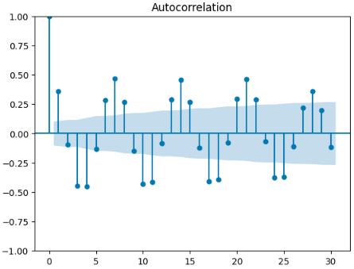
Market Demand Autocorrelation Analysis
Large indication that there is seasonality present
Consistent negative correlation between t and t-3, t-4
Consistent positive correlation between t and t-7

Slide 23
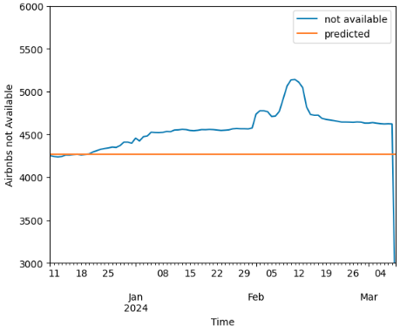
Market Demand Forecasting Model Evaluation
Mean absolute percentage error used as main evaluation metric
Simple Exponential Smoothing model performed the best among models created
Trained on 270 days of data, validated on 90 days of data
7.5% MAPE
SES model seems to be underestimating market demand

Slide 24
Market Supply/Demand Takeaways
Forecasting models perform much better when forecasting market demand compared to market supply
Simple exponential smoothing model performed the best
Great for short term forecasting, may not be reliable for long-time forecasting
Improvements could be made with model performance if data covering a longer period of time were available

Slide 25
What Makes an Airbnb Successful

Slide 26
Important Definition
Successful Airbnb: individual Airbnb listings that were booked for 180+ days in a 365 day time period
Successful = 1 if Airbnb is booked for 180+ days, else successful = 0

Slide 27
Airbnb Characteristics Considered
Number of people the particular Airbnb accommodates
Number of beds and bedrooms
Price
Minimum nights required to stay
Maximum nights that can be rented at a time
Number of reviews in the last 365 days
Review scores (cleanliness, location, communication, etc.)
Property type (home, townhouse, suite, etc.)
Type of room (home, hotel, etc.)
Number of bathrooms

Slide 28
Modeling Approach
70% of data used for training, 30% for validation
Numerical variables were imputed based on distribution
Categorical variables had very low percentage of missing values, were placed into ‘Other’ category
Evaluation metrics used: accuracy, precision, recall, F1 score, AUC
Three different models created:
Logistic Regression
Decision Tree (max depth = 4)
XGBClassifier (max depth = 4)

Slide 29
Evaluation of Models
Model: | Accuracy | Precision | Recall | F1 Score | AUC
Logistic Regression | 60% | 59% | 37% | 46% | 61%
Decision Tree | 62% | 60% | 54% | 57% | 62%
XGBClassifier | 69% | 68% | 60% | 64% | 68%

Slide 30
Takeaways from XGBoost Model
Lower priced Airbnb’s tend to be more successful
Location is crucial to a Airbnb’s success
Airbnb’s that categorize as bed and breakfasts are more likely to be successful compared to other property types
Smaller properties tend to be more successful than bigger properties

Slide 31
Questions?

